Slide 1
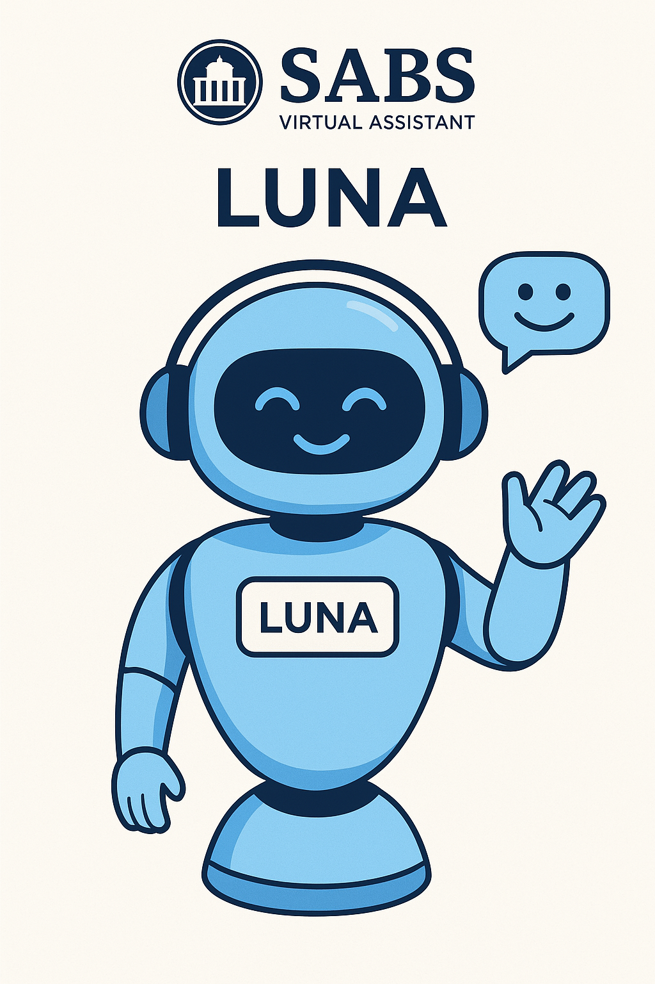
LUNA – AI Powered Virtual Assistant for SABS College
IBM SkillsBuild Winter Certification Program Applied Artificial Intelligence
Name: Jahnavi.M
Course: Persuing BCA
College : Seshadripuram Academy of Business Studies

Slide 2
INTRODUCTION
Luna is an AI-powered virtual assistant developed using Python to support students and visitors of SABS College.
It is designed to provide instant and accurate information related to admissions, courses, events, placements, facilities, and other college-related queries.
The chatbot uses Artificial Intelligence techniques such as Natural Language Processing (NLP), sentiment analysis, and speech recognition to interact with users in a human-like manner.

Slide 3
PROBLEM STATEMENT
In many educational institutions, students and visitors depend on static websites or manual enquiry systems to get information.
These systems are often slow, confusing, and not available 24/7.
Students face difficulty in finding quick answers regarding admissions, courses, events, and placements, which leads to delays and frustration.

Slide 4
USE CASE SELECTION
Selected Use Case: AI Chatbot / Q&A Assistant
This use case was chosen because:
It solves a real-world problem
It is widely used in education and business
It demonstrates automation and interactivity
It reduces human effort and response time

Slide 5
AI AGENT DESIGN – WHAT LUNA DOES
The Luna chatbot is designed to:
Answer frequently asked questions about the college
Understand user intent using keyword-based NLP
Detect user emotions and respond with emojis
Convert voice input into text
Translate different languages into English

Slide 6
AI CONCEPTS USED
The following AI concepts are used in this project:
Natural Language Processing (NLP) for understanding text
Rule-based logic for decision making
Sentiment Analysis to detect user emotions
Speech Recognition for voice input
Automation through Flask backend

Slide 7
TOOLS & TECHNOLOGIES USED
Programming Language: Python 3.10
Backend Framework: Flask
AI Libraries:
SpeechRecognition
TextBlob
Deep Translator
Frontend Technologies:
HTML
CSS
JavaScript

Slide 8
CODE SUMMARY
The Luna AI agent is developed using Python and Flask.
The code is structured in a modular way to handle user interaction, AI processing, and response generation.
It integrates natural language processing, sentiment analysis, speech recognition, and automation, making it a functional AI agent suitable for real-world applications.
The backend uses Flask to manage API routes and server communication.
Rule-based NLP logic is implemented to identify user intent using keywords.
TextBlob is used for sentiment analysis to detect emotions.
SpeechRecognition handles voice input, and a translation module supports multilingual users.
Random response selection makes the chatbot’s replies feel natural.
First, the user provides input either through text or voice.
If the input is in another language, it is translated into English.
The sentiment of the message is analyzed to understand the user’s emotion.
The chatbot then detects intent using keywords and selects an appropriate response.
An emoji is added based on sentiment, and the final response is displayed to the user.

Slide 9
DEMONSTRATION & OUTPUT
The chatbot demonstrates:
Real-time question answering
Emotion-based emoji responses
Voice interaction
Fast and accurate output
Find the complete code and documents here:
Jahnavi-Analyst/AI-Agent: Luna is an AI-powered chatbot built for SABS College

Slide 10
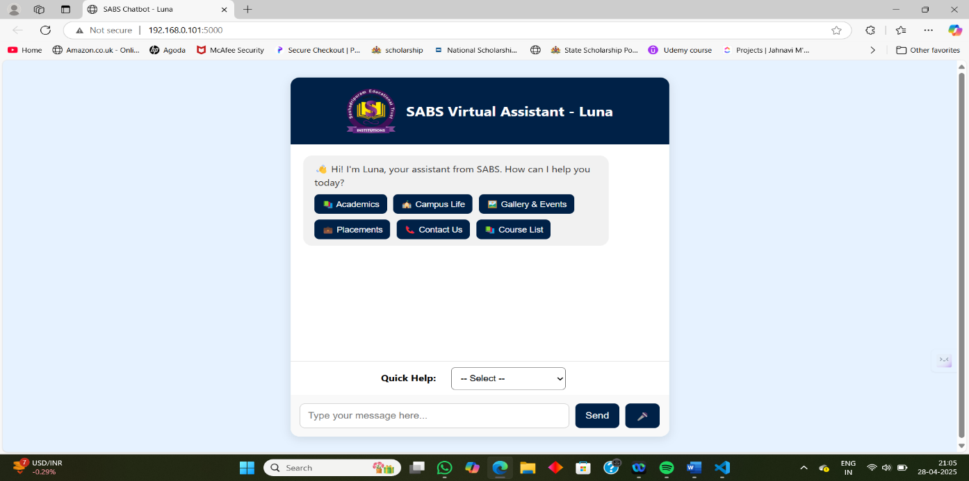
SCREENSHOTS

Slide 11
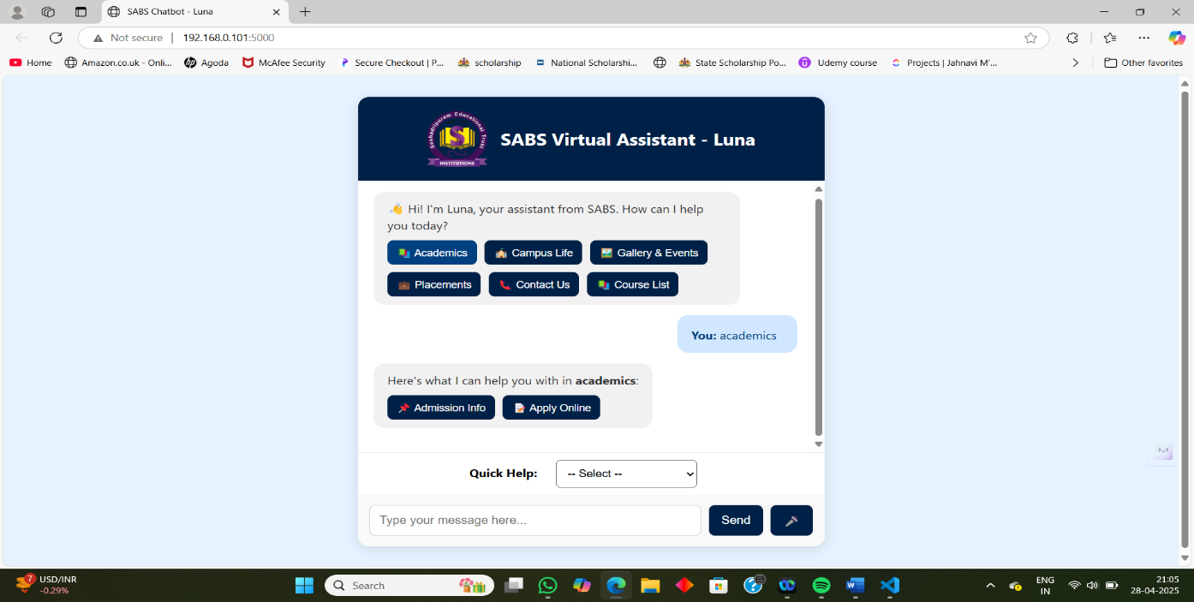
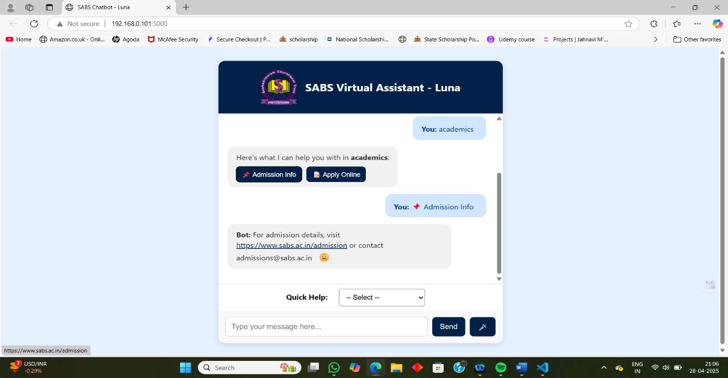

Slide 12
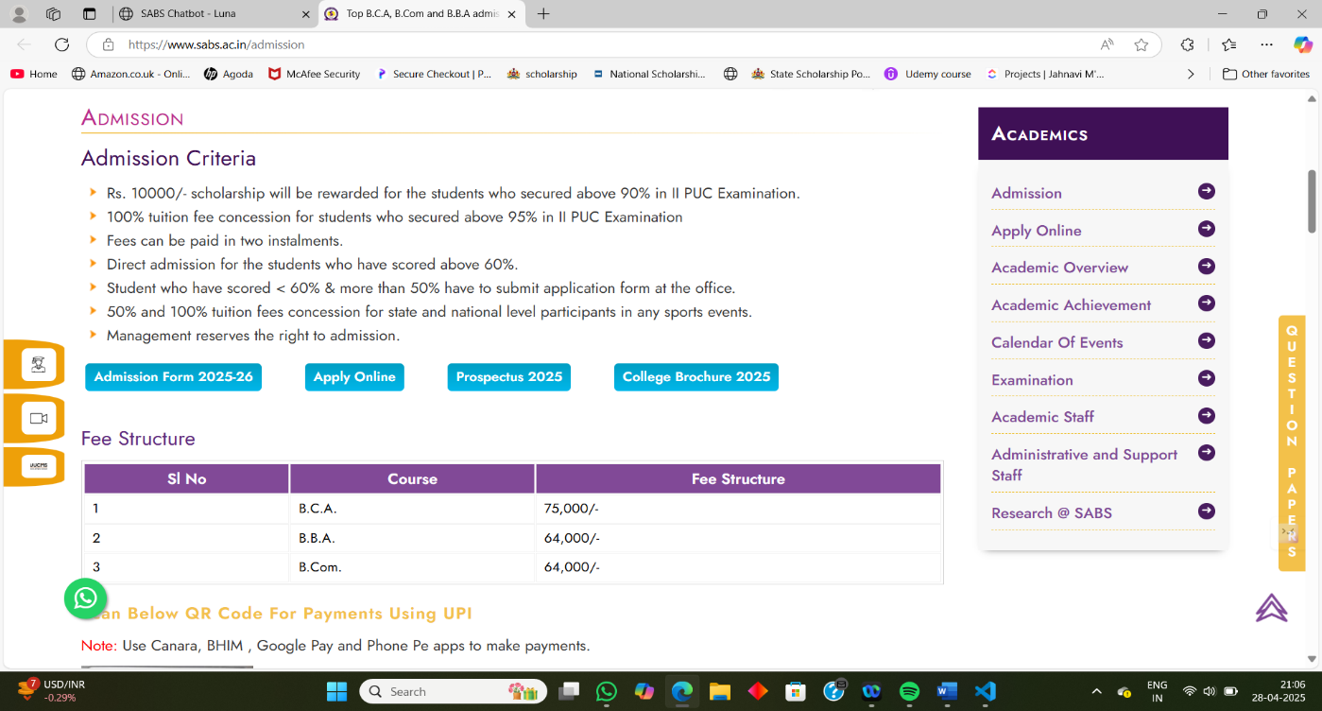
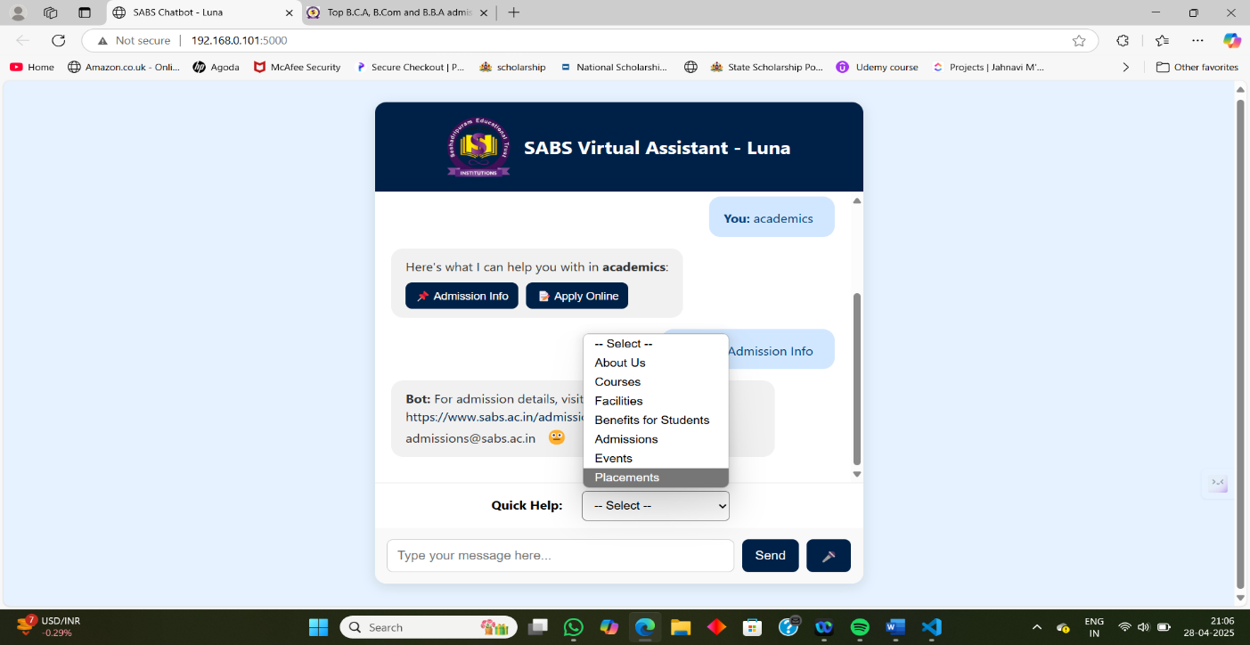

Slide 13
